Slide 1


Tools and data to decarbonize cities: Citiwatts, CoolLIFE and an EU-27 Mapping of Financing Schemes
Giulia Conforto e-think energy research
Mostafa Fallahnejad, TU Wien Aadit Malla, TU Wien
DSC Europe 2024
November 18th, 2024
Credit: BanksPhotos

Slide 2
Table of contents
Citiwatts: further advancing the Hotmpas Toolbox
CoolLIFE Tool: functionalities and Calculation Modules to meet sustainably the growing space cooling demand
CoolLIFE Knowledge Hub
EU-27 mapping of financing instruments: Zenodo & RHC Accelerator
SAPHEA Knowledge Hub: focus on Geothermal DHC
Q&A

Slide 3



Financing as a main barrier
Who pays? building retrofit, H&C upgrade, DHC
Funded by:
Financing
EU
National Local
EU-27 Mapping: public and private financing schemes for building decarbonization
EU Funding: are not enough, hard to apply for/get..

Slide 4
Mapping Overview
Almost 600 schemes
2/3 Public, 1/3 Private
Only Italy, Sweden and Slovakia more private than public schemes (bank fragmentation)
DHC, GeoDHC and Cooling were addressed the least
Budget Opacity

Slide 5
Types of Instrument and Sectors

Slide 6
Financing Instruments for Building Decarbonization

Slide 7
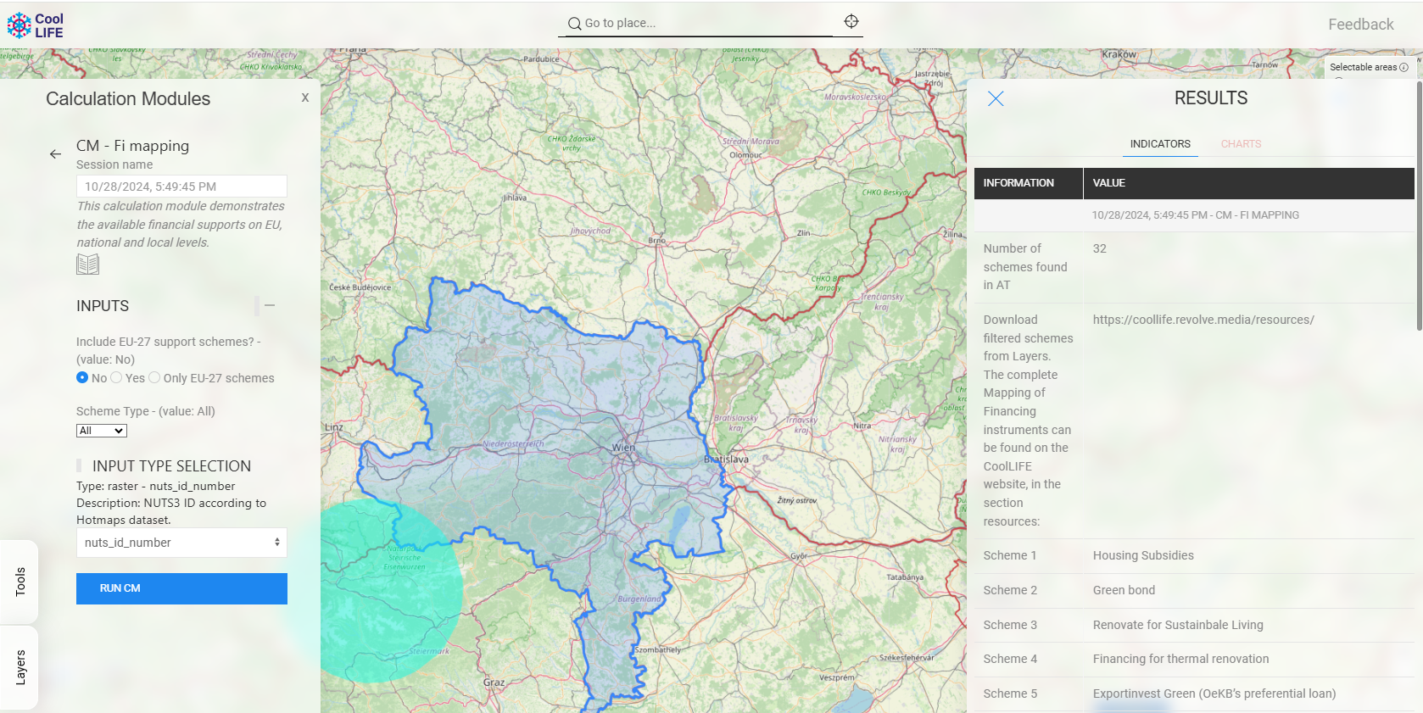
CoolLIFE
CoolLIFE Tool: https://tool.coollifeproject.eu/map

Slide 8
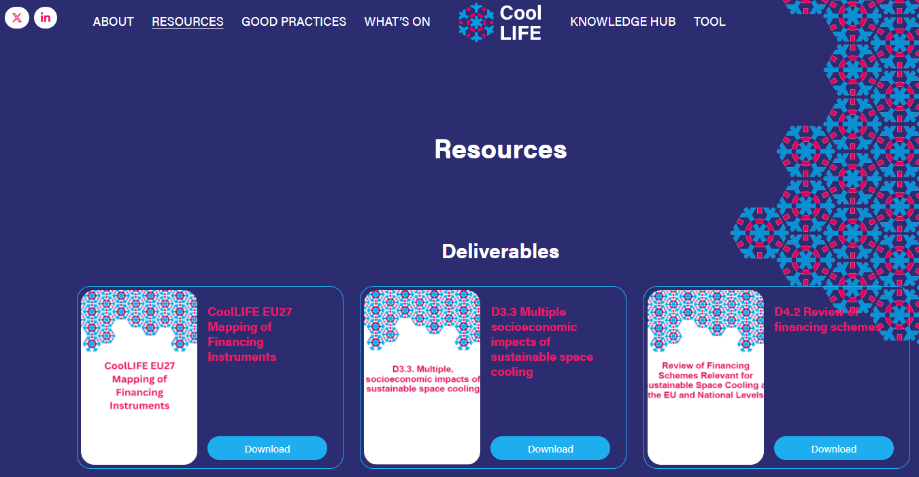
CoolLIFE
CoolLIFE Knowledge Hub & Resources: https://coollife.revolve.media/

Slide 9
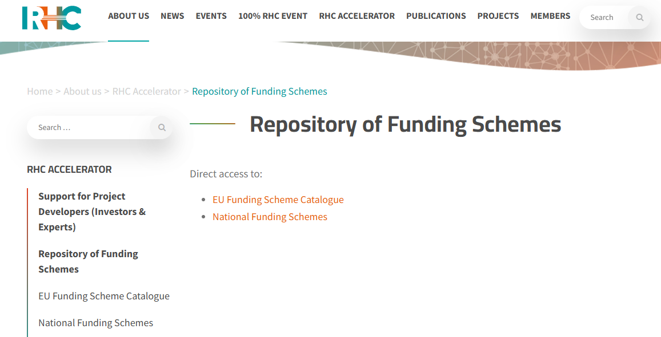
RHC Accelator
Repository of Funding Schemes: https://www.rhc-platform.org/about-us/rhc-accelerator/funding-scheme-catalogue/

Slide 10

Download the full Mapping of Financing Instruments
https://zenodo.org/records/13886860 Full Dataset: Building Decarb., H&C and DHC

Slide 11

SAPHEA
SAPHEA Market Uptake Hub: https://www.saphea.eu/

Slide 12

Please give us your feedback
https://forms.gle/Mid9XFEtV3HcteWN6

Slide 13


Giulia Conforto
conforto@e-think.ac.at
Thank you for your attention!
Credit: 1xpert

